Slide 1

Google Data Centers
(case study on Google)

Slide 2
What is Data Center?
A data center is a facility that centralizes an organization's shared IT operations and equipment for the purposes of storing, processing, and disseminating data and applications. Because they house an organization's most critical and proprietary assets, data centers are vital to the continuity of daily operations.

Slide 3
According to Google, their global data center operation electrical power ranges between 500 and 681 megawatts. The combined processing power of these servers might have reached from 20 to 100 petaflops in 2008. Google has 34 data center locations currently

Slide 4
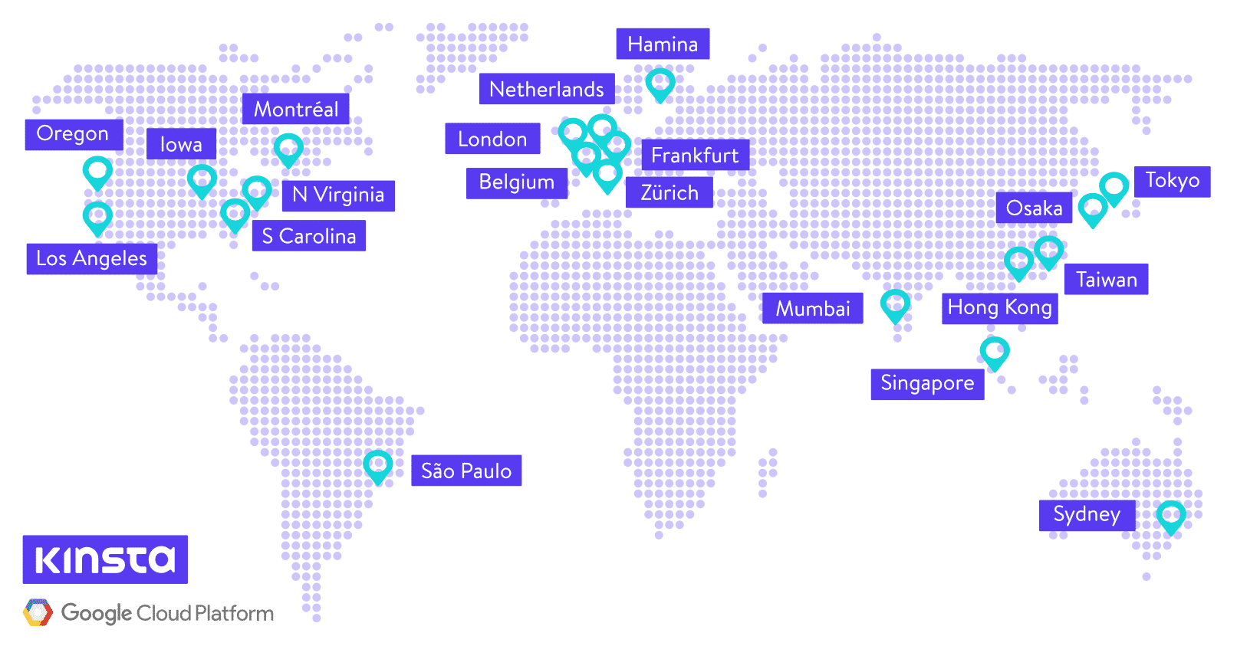

Slide 5
Efficiency:
It's 1 petabyte or 1000 terabytes or 1,000,000 gigabytes. It took six hours and two minutes to sort 1PB (10 trillion 100-byte records) on 4,000 computers and the results were replicated thrice on 48,000 disks.
Purpose:
A data center is a facility that centralizes an organization's shared IT operations and equipment for the purposes of storing, processing, and disseminating data and applications.
Consolidation:
Data center consolidation refers to technologies and strategies that allow for more efficient IT architectures. This can mean physically consolidating multiple data centers or just making a single large data center run more effectively on fewer resources.

Slide 6
Google organized the GFS into clusters of computers. A cluster is simply a network of computers. Each cluster might contain hundreds or even thousands of machines. Within GFS clusters there are three kinds of entities: clients, master servers and chunk servers.
​
How much data can be stored in a data center?
In 2018, data centers will store an estimated 547 exabytes of actual data.

Slide 7
Some interesting stats: 100k MapReduce jobs are executed each day; more than 20 petabytes of data are processed per day; more than 10k MapReduce programs have been implemented; machines are dual processor with gigabit ethernet and 4-8 GB of memory.
Which type of data center Google has?
Google Web Server (GWS) – custom Linux-based Web server that Google uses for its online services. Storage systems: Google File System and its successor, Colossus. Bigtable – structured storage built upon GFS/Colossus.

Slide 8
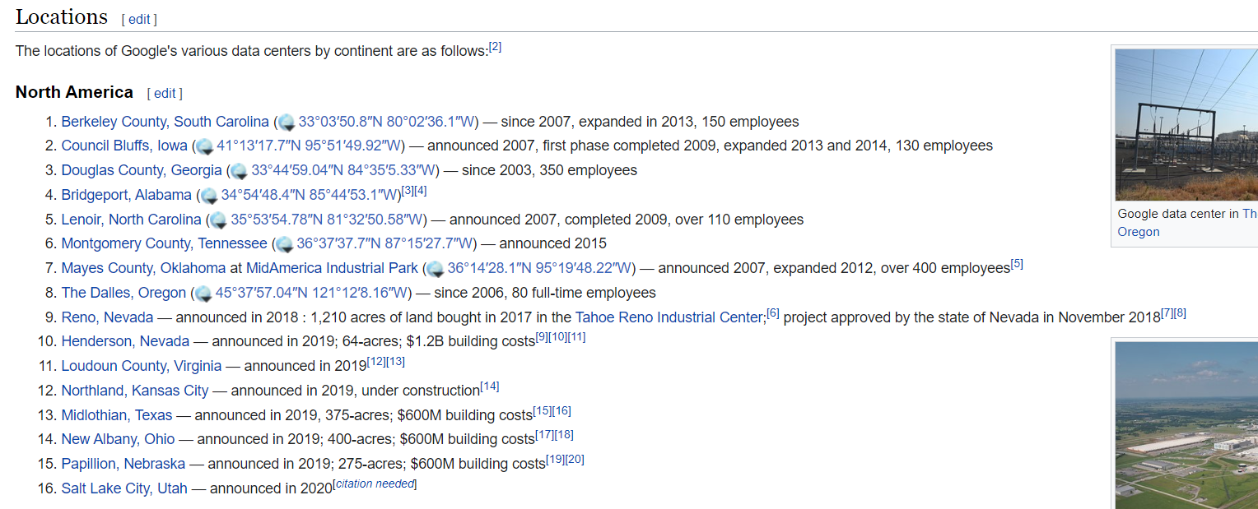

Slide 9
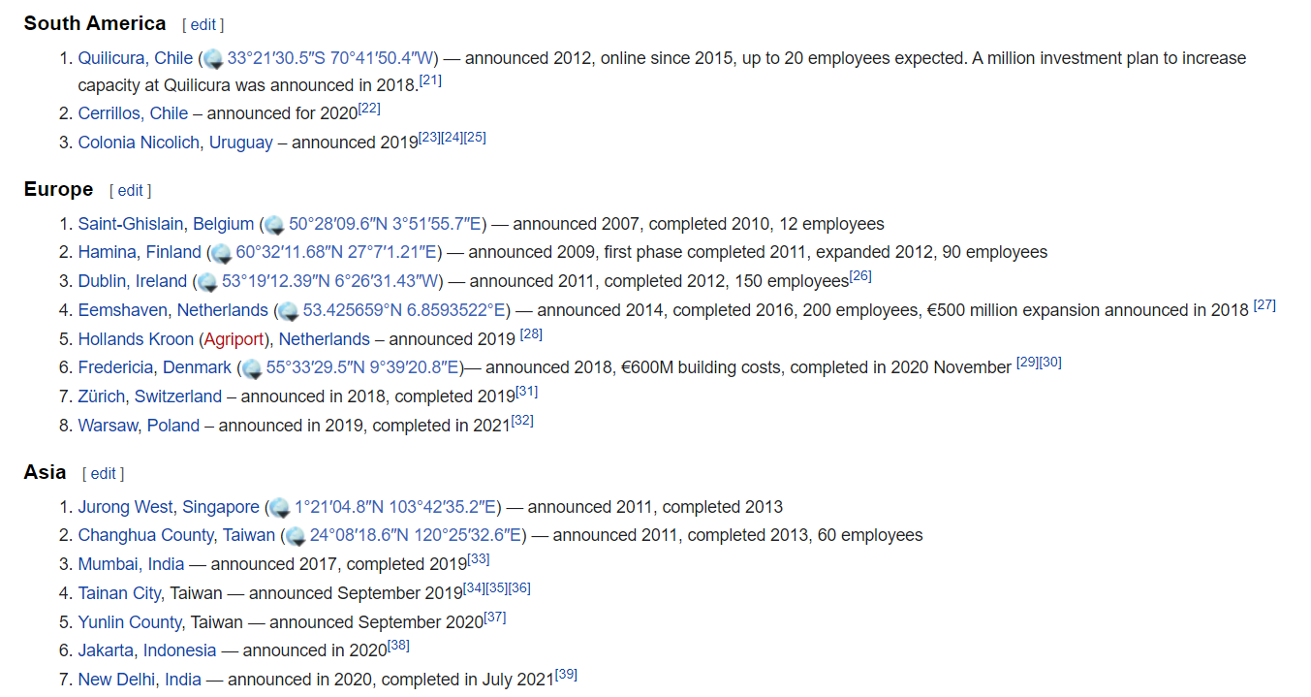

Slide 10
